Slide 1
The Microcredential Revolution in Higher Education

Slide 2
Society is changing

Slide 3
The Number of Students is Growing
Dr. David Wiley, TEDxNY

Slide 4
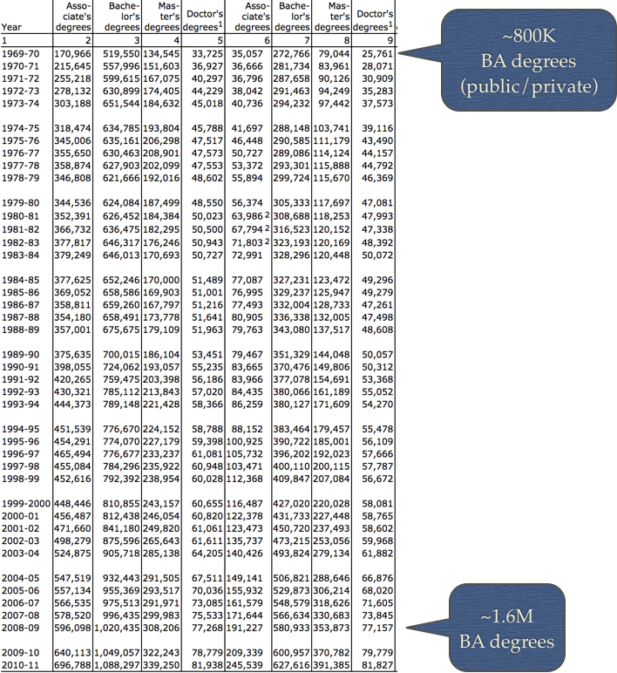
What about the next 40 years?
(data from http://nces.ed.gov/programs/digest/d12/tables/dt12_318.asp

Slide 5
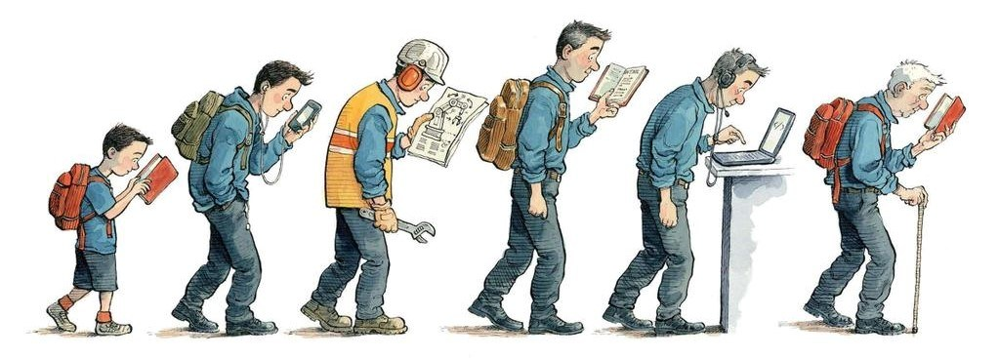
Lifelong learning is required.
The Economist, Jan 14, 2017

Slide 6
Dennis Callahan, Degreed

Slide 7
https://www.fraser.k12.mi.us/domain/168

Slide 8
July 7, 2017 By Canada Study News

Slide 9
Learning is Open
Michelle Pacansky-Brock August 26, 2015

Slide 10
That’s a good thing.
Students Are Taking Control
Cameron Pipkin Jun 10, 2015

Slide 12
We need new credentials to match 21st Century Learning

Slide 14
Comparing Credentials in Formal Education
Degrees awarded after a long period of time or a great deal of experience
Learning from ONE institution.
Transcripts have lots of information, but is it useable?
Credential detached from evidence and criteria
Learner doesn’t own the credential
BYU
Notes:
Increase number with new ones

Slide 16
How Valuable are Transcripts?
Course # | Course Name | Grade
CS 200 | Web Programming | B
What does 200 mean? Is it equal to or less difficult than a 400-level class? What about 400-level Programming for Humanities course? Is it half of a level 400 CS class?
Course name is vague: what skills are covered?
What does the grade B mean?
Average on everything?
Did really well on some things and poorly on others?
If so, what things did they do well on?
Notes:
Increase number with new ones

Slide 17
Physical and Digital Credentials
Physical Credentials
- Acknowledge accomplishment
- Display skills gained
Motivation
Hard to share, hard to save
Digital Credentials
Same Benefits as physical credentials -
Typically not sharable -
Gamification –

Slide 18
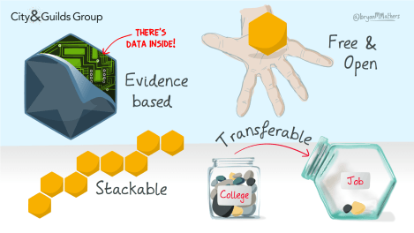
Introducing Open Microcredentials!
Small, focused on skills/knowledge
Can be transferred across systems
Shareable on CVs/social media
Data rich!

Slide 19
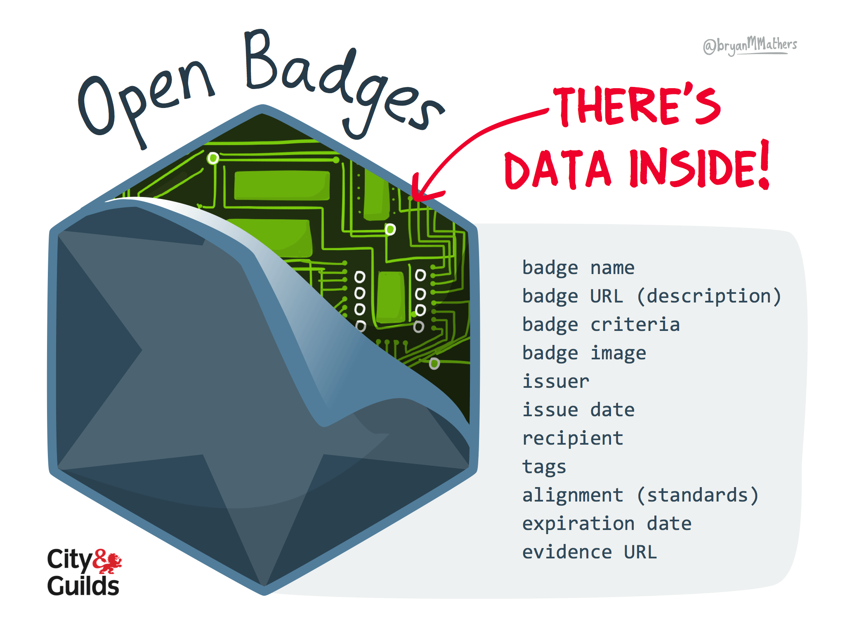
Open badges are digital images embedded with rich metadata
Badges tell a story about the:
Issuer
Learning objective
Earner
Not the same as a digital badge

Slide 20
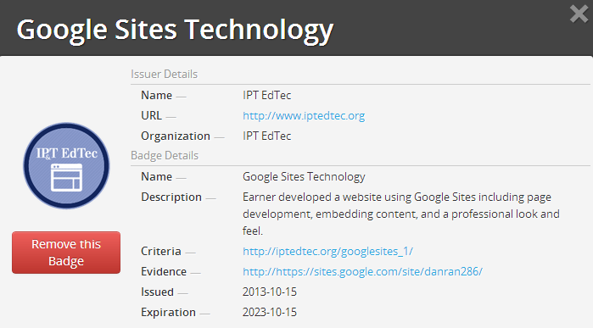
Credential Metadata

Slide 21
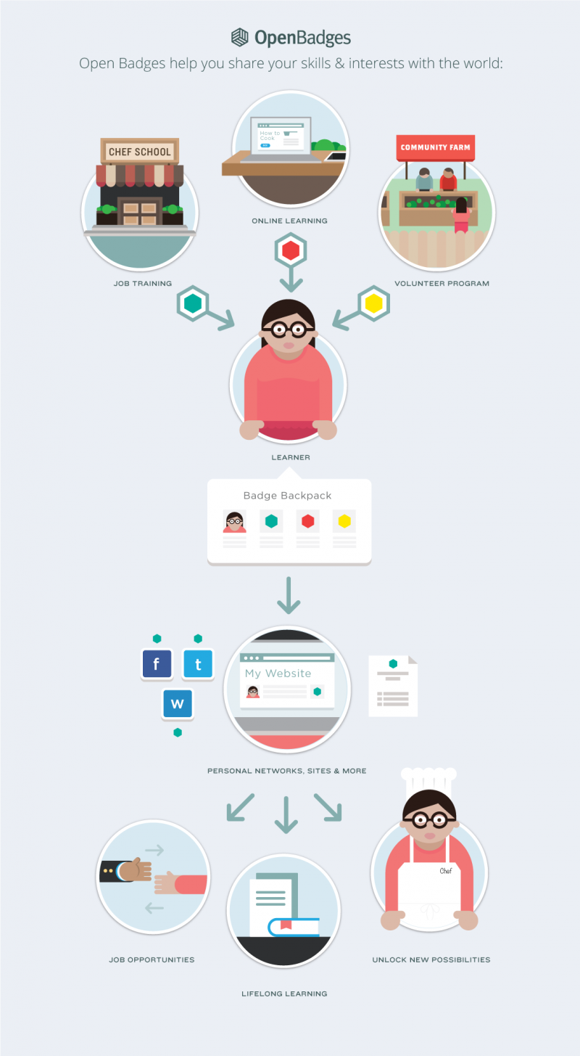

Slide 23
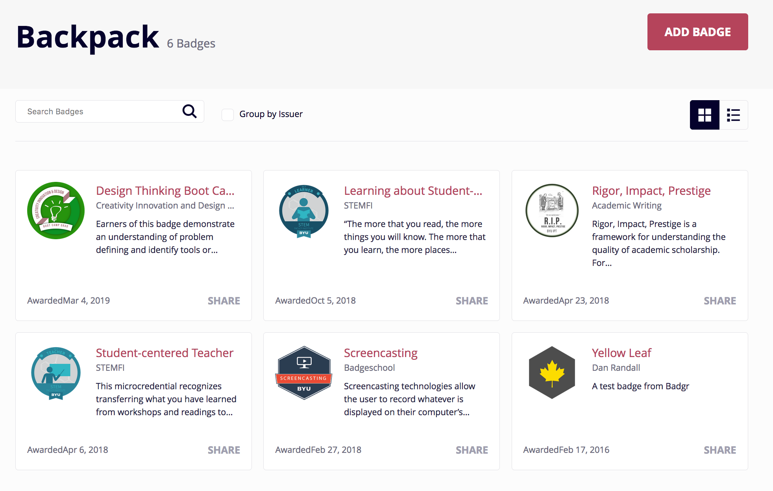
Open Backpacks/Portfolios

Slide 24
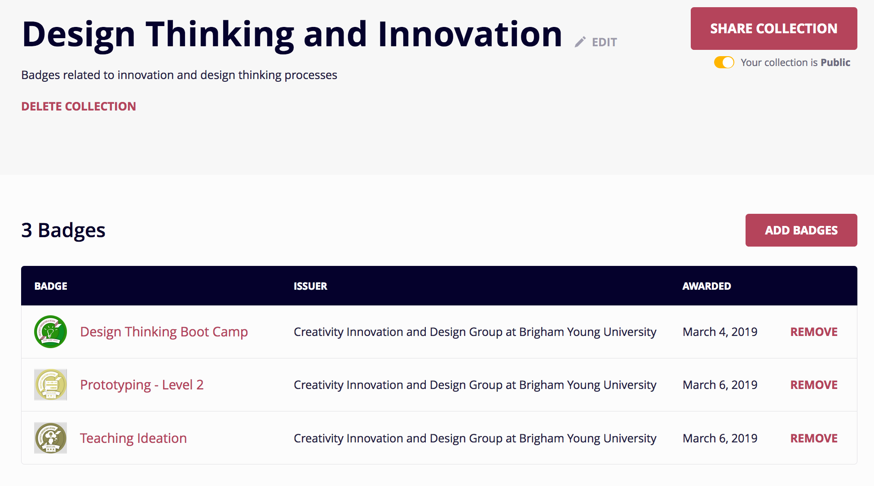
Backpack Collection
Multiple collections can be created.
Collections can be private or public and shared.

Slide 25
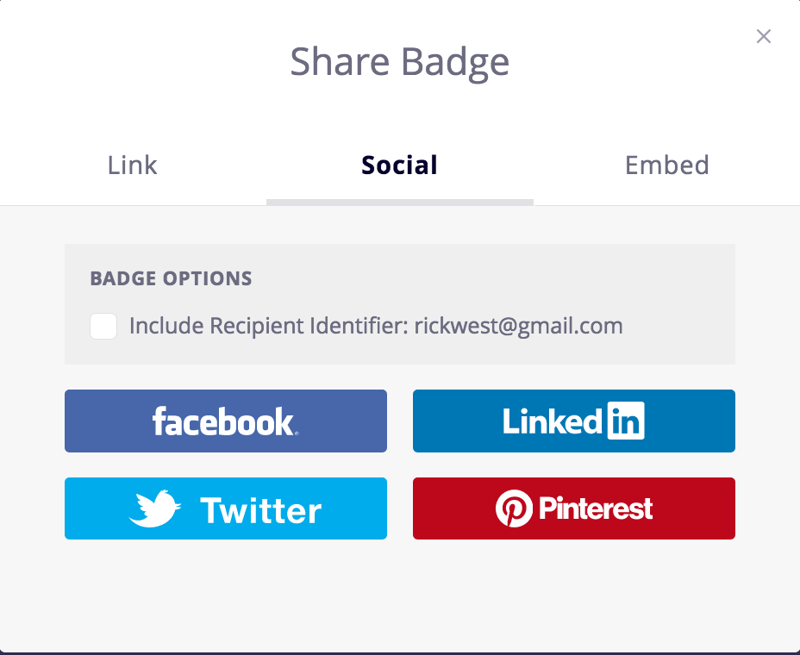
Easy to share, easy to post, easy to print

Slide 26
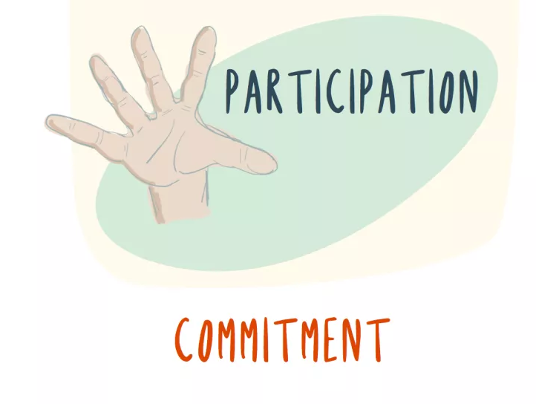
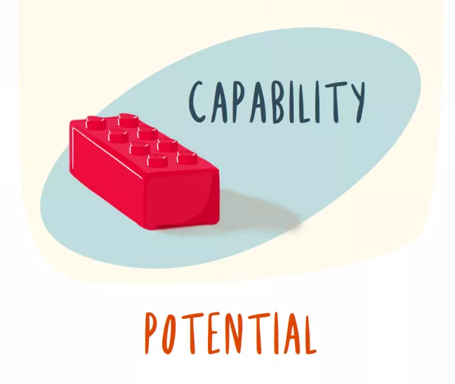
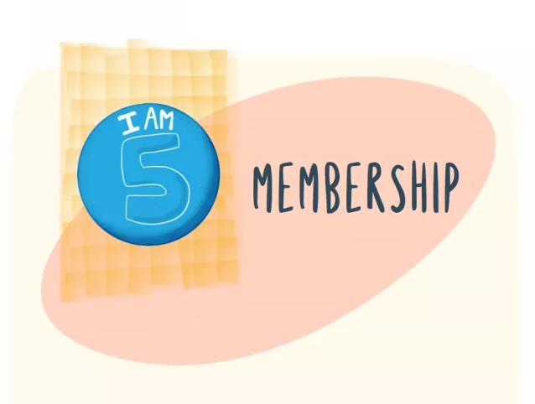
Types of Microcredentials
Membership
Attendance/Activity
Assignment or extracurricula
Knowledge
Participation & Roles
Competency
Character
Social Competency
Career/soft Skills
Bryan Matthews Images

Slide 27
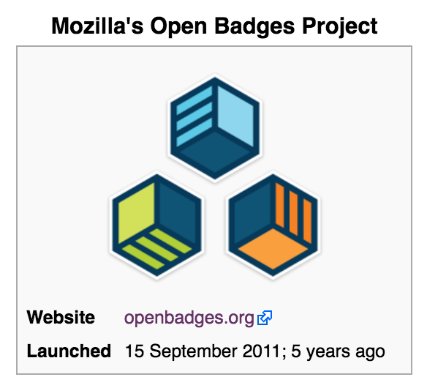
Over 1,500 issuing organizations!

Slide 28
What could be the advantage from credentials that are …
Open
Meta (data)
Competency-level instead of course level?

Slide 29
Let’s look at a few examples…

Slide 30
Badges are prerequisites for courses
Available to students throughout program
30 options for self-directed learning
Advertised as a perk of the program

Slide 31
Student Transformative Learning Record

Slide 35
Slides from:
David Leaser, Senior Program Manager, Innovation and Growth Initiatives at IBM

Slide 36
Badge Types: Four unique emblems for resume worthy achievements
Explorer Knowledge Completes a quiz or assessment Academic knowledge Formal training Informal education Mentoring | Advocate Skills Demonstrates a skill or has applied the skill Compete in Challenges Competes in Hackathons Answer questions Author articles Hosting a meeting Present at an event Teach on the subject Create YouTube video Create references and testimonials | Inventor Capabilities Designs and develops new solutions Proves ability to build and implement novel solutions to exceptionally difficult and complex challenges - for IBM, clients or society Publishes an app on GitHub Publishes an app in the marketplace | Certified Authority Has completed a solution, certification or developed a certification Provides an additional benefit which can automatically be shared to social media sites or included on their websites or e-mails | Excellence Eminence Deep understanding of highly complex subjects Deep expertise, exceeding the skill level of experienced professionals Influences and mentors others to help them make best use of IBM software and solutions Among the most trusted advisors, helps to grow and nurture the community of like-minded professionals

Slide 37
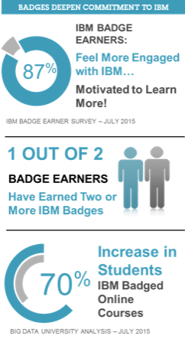
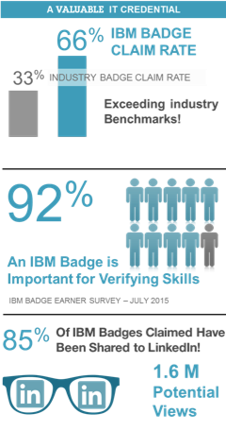
Badges are generating significant results for IBM and our ecosystem
WHAT BADGE EARNERS ARE SAYING
"I find the badge program a great way of learning and hope more badge options will be offered soon.”
"In a recent interview, this badge gave me a chance to elaborate about a learning activity that helped improve my skills.“
"More people are viewing my LinkedIn profile after adding the IBM badge to my list of accomplishments.“
"A truly worthwhile initiative that allows validation of my knowledge and skills. Way to go IBM! Thanks."
IBM badge earners are also leveraging the power of Twitter and Facebook to promote their IBM emblem
IBM BADGE EARNER SURVEY – JULY 2015
"IBM's success with Open Badges shows the IBM brand has real value in the market as an IT accreditation.” Peter Janzow, Senior Director, Open Badges Lead, Pearson VUE

Slide 38
Big Data University Case Study: 14 Online Courses
Student Enrollments
% of Enrollments Completing Courses
129%⬆
Increase in enrollments compared to six week period leading up to launch of badge program
226%⬆
Increase in course completion rate when compared to six week period leading up to launch of badge program
15,010
3,505
2,061
40% Avg for all other courses
No. of Students Passing EoC Assessment
EoC Assessment Pass Rate to Enrollments
694%⬆
Increase in number of students passing EoC assessments compared to six week period leading up to launch of badge program
9442 / 24253
255%⬆
Increase in the rate of students enrolled who went on to pass the EoC assessment
1189 / 10589
1975 / 12260
23% Avg for all other courses
Notes:
Big Data University Open Badges represent 33% of all IBM Open Badge Pilot Program badge offerings (Pilot includes 21 badge offerings in total)
Big Data University represents 79% of all IBM Open Badges issued to-date (as of July 17, 2015)
BDU Enrollment, Completion and Test Pass data derived from Big Data University reporting system. Metrics derived from BDU enrollment and completion data as measured in the six weeks prior to launch of the IBM Open Badge program, and in the six weeks following launch of IBM Open Badge program.
Data Capture Timeframes:
Apr 20 – May 29 (Before Badge Program Analysis)
Jun 01 – Jul 10 (After Badge Program Analysis)
Social Media Impact Notes – Metrics based on the following:
Per LinkedIn Profile Average 1st Level Connections: 500 (Source: Statista – May 2014)
Per Facebook Profile Average No of Friends: 300 (Source: Pew Research – Feb 2014)
Per Twitter Account Average no. of Followers: 200 (Source: Statista – March 2015)

Slide 39
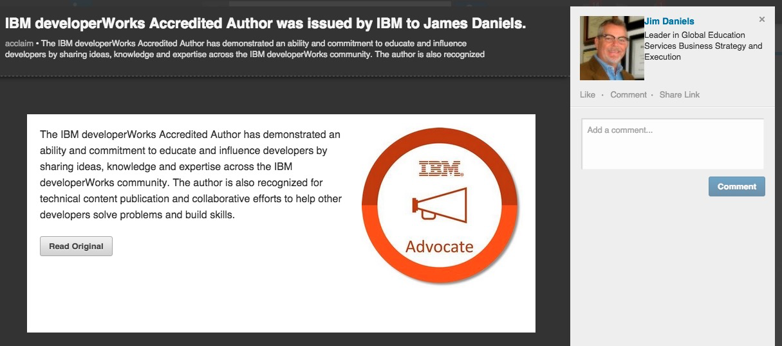
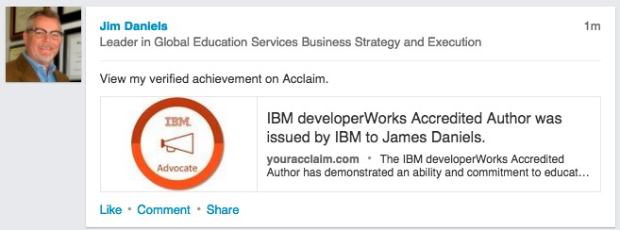
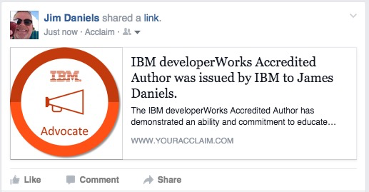
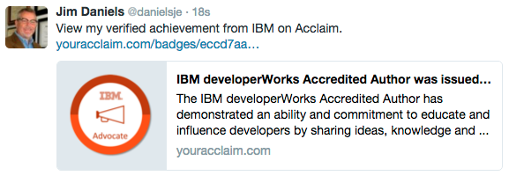
The social media impact is enormous: 2.8 million potential views for every 10,000 badges that are claimed
Profile View
Newsfeed
A printed certificate might reach 8 people who walk past an office and notice it on the wall
NOTE: LinkedIn profiles with certifications and badges receive 6x the number of profile views.
Notes:
Twitter – 40,000 Views
LinkedIn – 2,700,000 Views
Facebook – 79,000 Views
Based on IBM Open Badge Pilot Program average claim rate of 66%
Twitter: Based on actual IBM Open Badge Pilot Twitter share rate of 03% of claimed badges – Assumes avg. Twitter Account following of 200
LinkedIn: Based on actual IBM Open Badge Pilot LinkedIn share rate of 83% of claimed badges – Assumes avg. LinkedIn profile following of 500
Facebook: Based on actual IBM Open Badge Pilot Facebook share rate of 04% of claimed badges – Assumes avg. Facebook profile following of 300
LinkedIn Profile views: According to LinkedIn, profiles with certifications and badges receive 6x more views from recruiters and potential employers.

Slide 40
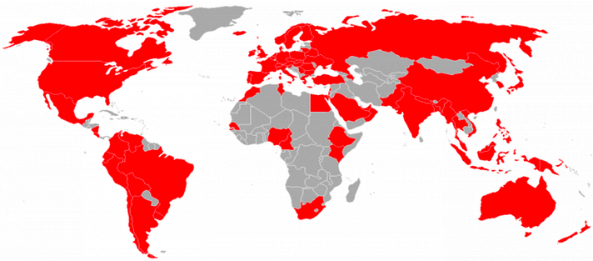
Open Badges: IBM badges have been issued to individuals from 81 different countries within the first eight weeks of the program
IBM Confidential: For Internal Use and Distribution Only
03
09
30
Regional Penetration
Percentage of countries by region
where IBM badges have been claimed
Number of Countries by region where IBM badges have been claimed
15
07
09
03
02

Slide 41
Evidence: Badges provide real value to employers and badge earners
“As an IT Consultant I have noticed that during job interviews for new customer assignments the interviewer has already checked the consistency of my resume with LinkedIn.”
“I was contacted for a job by someone who saw the badge activity.”
“While my "alphabet soup" has always been listed, changing that for graphic badges has increased attention, comments and understanding of my credentials. “
“A potential employer was able to verify my credentials.”
“A lot of people in my LinkedIn list did not know that I am CCE certified till I posted my badge.”
“The ability to show customers the badge eases their minds when thinking about allowing me (the engineer) to get close to their environment.”
Top four responses to Pearson VUE’s surveys on where badges show value:
Verify a job applicant's credentials
81%
Allow employer to verify your credentials
77%
Receive notifications about job opportunities
76%
Display your credentials online
73%

Slide 42
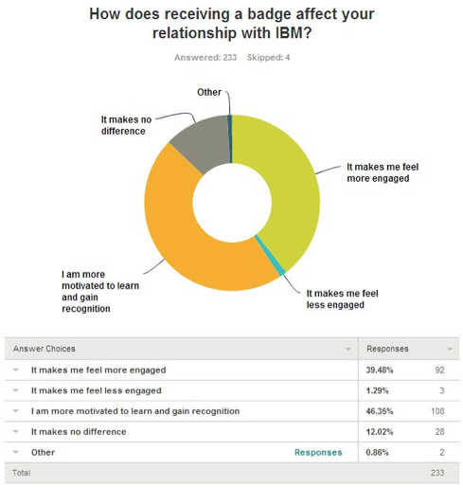
IBM Open Badge Program Survey: What the Badge Earners are saying about the program
Notes:
Based on IBM Open Badge Pilot Program average claim rate of 66%
Twitter: Based on actual IBM Open Badge Pilot Twitter share rate of 03% of claimed badges – Assumes avg. Twitter Account following of 200
LinkedIn: Based on actual IBM Open Badge Pilot LinkedIn share rate of 83% of claimed badges – Assumes avg. LinkedIn profile following of 500
Facebook: Based on actual IBM Open Badge Pilot Facebook share rate of 04% of claimed badges – Assumes avg. Facebook profile following of 300
LinkedIn Profile views: According to LinkedIn, profiles with certifications and badges receive 6x more views from recruiters and potential employers.

Slide 43
Over 19,000 credentials issued
Credentials for users/customers of product
Tied to online training
78% indicated they would participate again
83% believed it improved their skills
67% shared their credential online
93% acceptance rate

Slide 44
Five Badge Systems
Technology Skills for Teachers (+ consortium)
Faculty Professional Development
Academic Writing Skills
Optional Student Technology Training
Design Thinking

Slide 45
My Context
Technology Skills for Teachers in Training
2012
One class, 1 credit
15+ potential majors, different abilities & needs
Taught by different departments
Required prerequisite skills
How do we provide personalized learning opportunities?
How do we provide extension beyond the course?

Slide 46
“Professor, my principal wants to have me lead on a technology initiative. Can you email him and tell him what my technology skills are?”

Slide 47
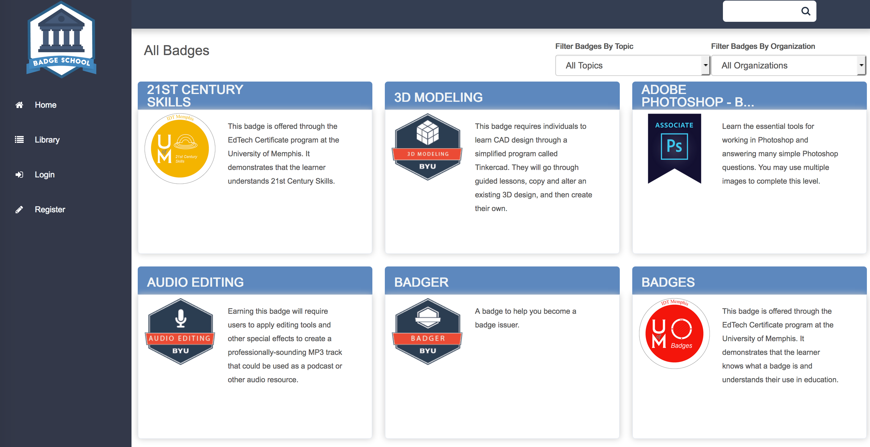
BYU EdTec Badges

Slide 48
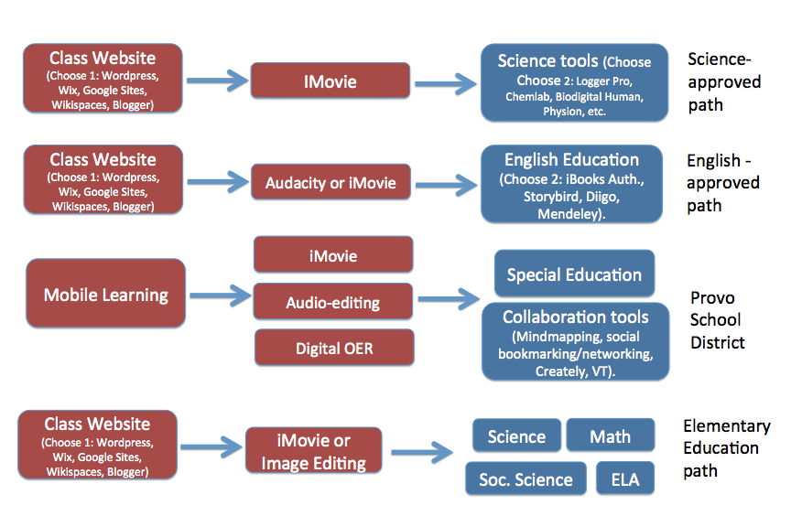

Slide 49
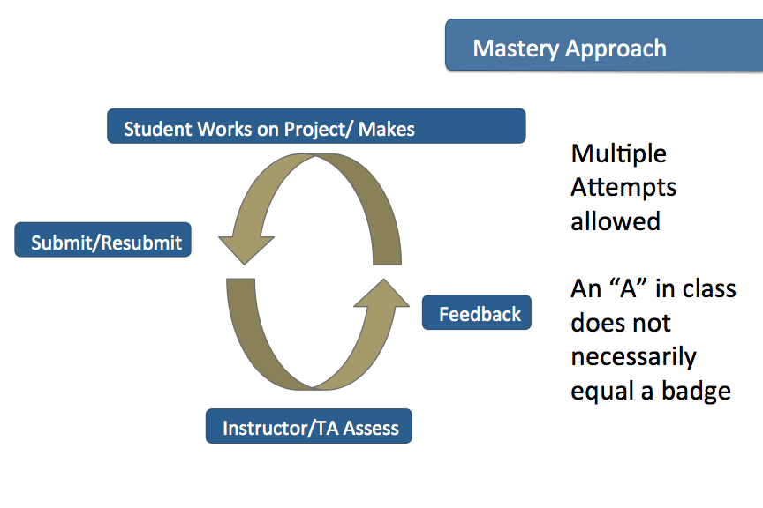

Slide 50
Next step: Partnering Around Standards
Notes:
Who am I missing????
For Rick: I need to make the google folder, along with an instruction “read me first” that’s in the folder.

Slide 52
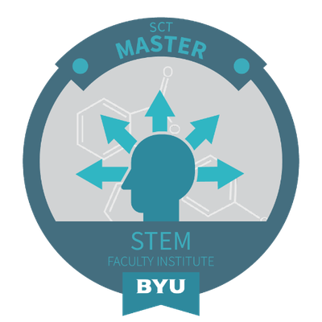
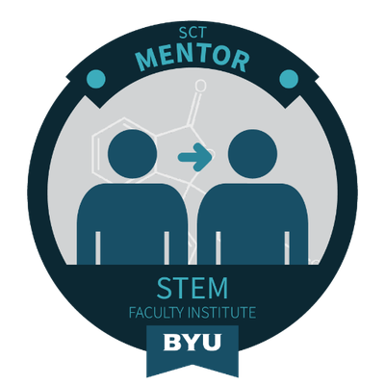
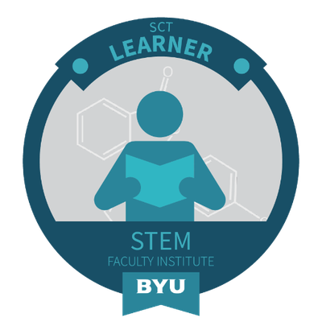
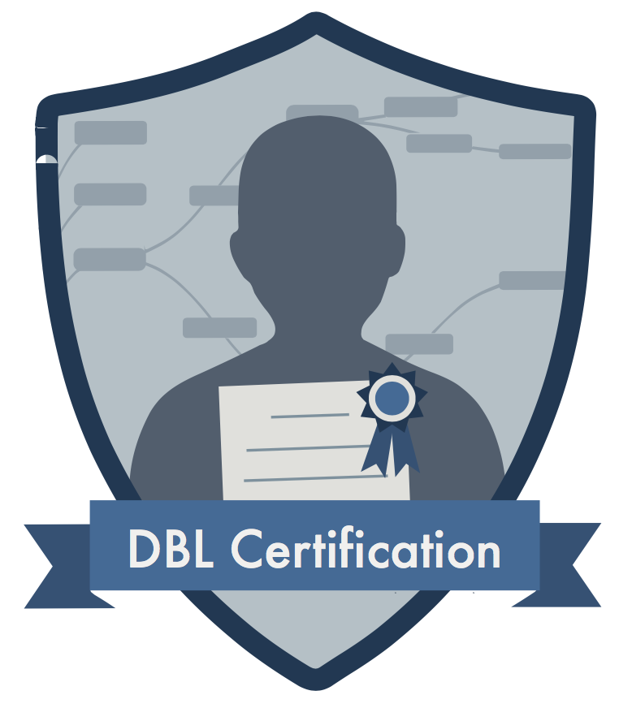
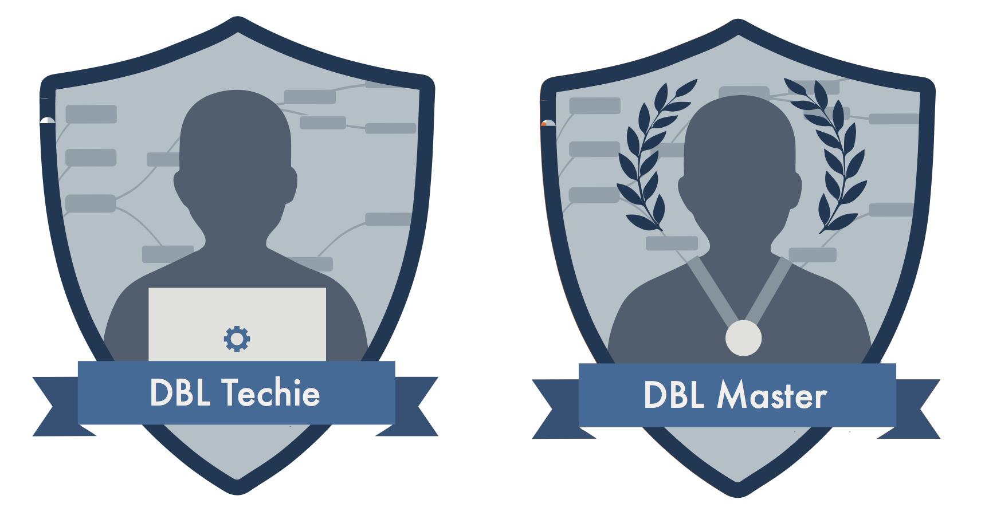
Faculty Professional Development

Slide 53
Interdisciplinary Design Thinking

Slide 55
Benefits Seen So Far
We are better teachers
We are thinking deeply about standards
Our students have more options
We can grow and create more badges
More legitimacy through endorsements

Slide 56
A Few FAQs …
How do you assess the important things?
However … creating microcredentials does force us to think about our assessments. I have found my assessments are much better in microcredentials
https://dailyalchemy.com/stop-creating-problem/

Slide 57
2. How do you know someone really earned the credential?

Slide 58
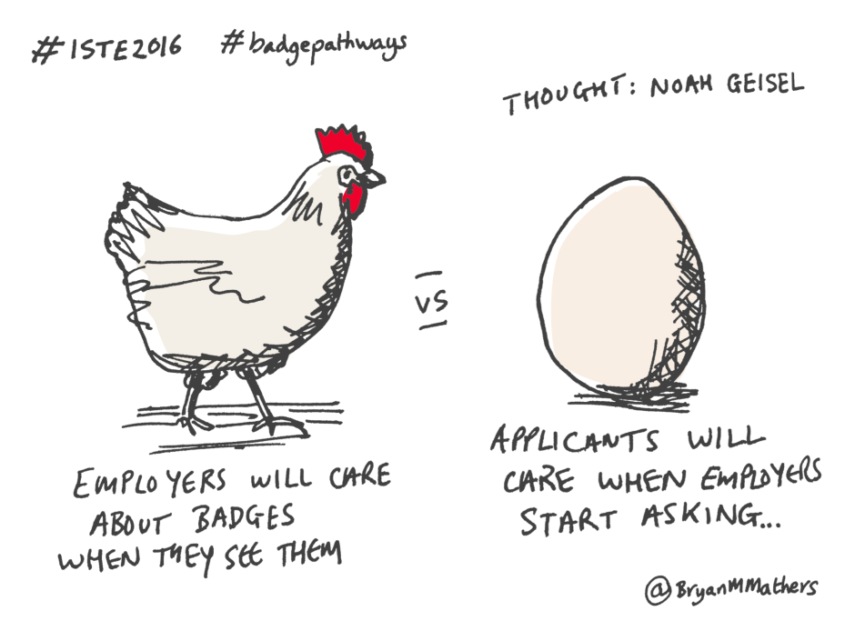
3. Will employers recognize these credentials?

Slide 59
One solution …
Work with employers to create badges
Have employers endorse badges
Have employers recommend badges for employees
(Source: Asia Info Blog)

Slide 60
4. Will students like this?
Primorska student responses:
“It … could separate me from the others. It could be interesting note in my CV”
“I think it can be useful tool to summarize our skills when we want to apply for a job.”
“I can’t understand why I didn’t know about this before … Definitely I would like to have my knowledge somewhere … one place.”
“They can help students to get more attention to what they are doing. It is really interesting.”
“It’s a great idea to motivate students or young people to learn more.”
”It’s a great way to be recognized for effort we put into learning something.”
“I believe it should be the future.”
“Great boost in student motivation”
”This is an excellent idea.”

Slide 61
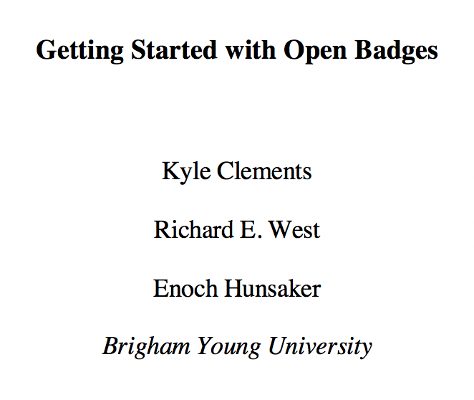
5. How do I get started?
Email me for our paper!

Slide 62
A thought on why this all matters ...

Slide 63
“An open education infrastructure, which can support extremely rapid, low cost experimentation and innovation, must be comprised of at least these four parts:
Open Credentials
Open Assessments
Open Educational Resources
Open Competencies”
From https://lidtfoundations.pressbooks.com

Slide 64
Mentored Authentic Experience

Slide 65
How can microcredentials benefit Primorska? Let’s find out! I will be visiting Primorska from May 20-June 20!

